Slide 1
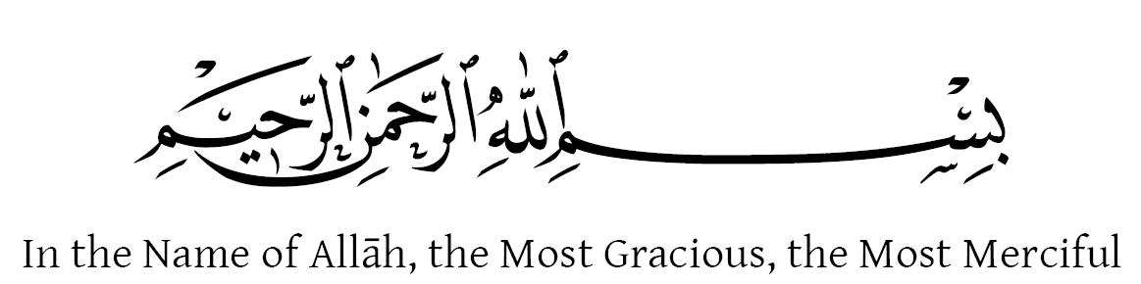


Slide 2

Diabetes Management System Using Food Recognition
Supervised by:
Dr. Muhammad Sardaraz
Group Members:
Riffat Nadeem(FA17-BCS-076)
Seerat Shafique(FA17-BCS-109)
Presented on 28 May 2021
Department of Computer Science
COMSATS University Islamabad, Attock Campus

Slide 3
Outline
_______________________________
Introduction
Related Work
Problem Statement
Objectives
Functional Requirements
Non-Functional Requirements
Modules
Architecture Overview
Methodology
Implementation Of Mask R-CNN
Dataset
Diagrams
System Snapshots
Conclusion
Future Work
Tools and techniques
___________ _____

Slide 4
Introduction
Specially designed for diabetic patient
Inform patients to take their medicine on time
Keeping track of user route.
Recognize and recommend food which is suitable for diabetic patient
_______________________________

Slide 5
Problem Statement
Old health care technologies and lifestyle changes failed to help diabetic patients.
It is a great responsibility of diabetic patient to take good care of their health.
To follow proper treatment.
_______________________________

Slide 6
Related Work
Diabetes Management app assist user to remain track of their food and diet details, and exercise time.
mySugr-Diabetes App & Blood Sugar auto-logs diabetic patients information and suggest his day-by-day treatment data like meals, diet, medicine, blood glucose levels and Insulin levels.
Freedom from Diabetes gives exceptional methodology by staying connected with an expert team get every day messages identified with diet, work out. Also keep track of their medicines.
_______ ____________________ _

Slide 7
Objectives
Helping the diabetic patients to find if food is recommended to eat or not.
Medication reminder that notify patients to take medication.
Keeping track of patients daily and weekly route.
_______________________________

Slide 8
Functional Requirements
User authentication
Recommending food for user by telling how much calories it contains.
Keeping record of user's medicine.
Tracking user’s walking and running activity.
_______________________________

Slide 9
Non- Functional Requirement
Efficiency
Learnability
Maintainability
Reliability
Usability
Availability
Performance
Understandability
_______________________________

Slide 10
Modules
Our application have three main Modules.
Calories Recommender
Medicine Reminder
Activity Tracker
_______________________________

Slide 11
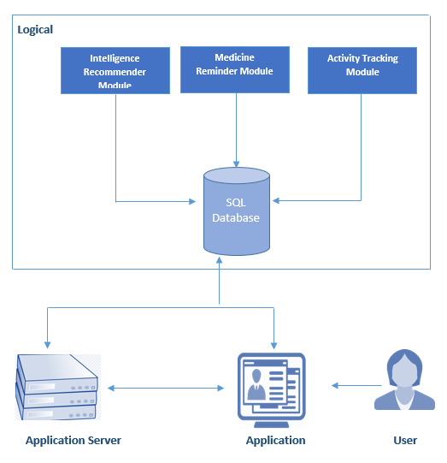
Architecture Overview
_______________________________

Slide 12
METHODOLOGY
_______________________________

Slide 13
Methodology
Integration of google APIs.
Image Acquisition
We acquired the image from android and send it to server by using rest API in python flask framework
Segmentation
Then segmentation will be performed to extract region of interest from image by applying some mask on the image.
Mask R-CNN Algorithm
Then apply Mask R-CNN classifier in which our dataset get optimal classification.
_______________________________

Slide 14
Implementation Of Mask R-CNN
Clone the repository
Prepare the dataset
Prepare the model
Train the model
Testing and results
_______________________________

Slide 15
Dataset
Dataset contain 13 classes of food.
Images used in dataset are RGB images and are in (.JPG) format.
Splitting of Data
80% training subset
20% testing subset
_______________________________

Slide 16
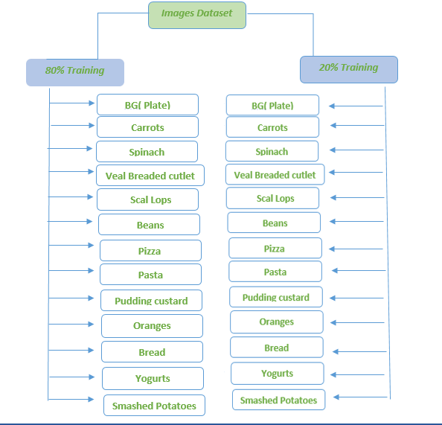
Split Dataset
_______________________________

Slide 17
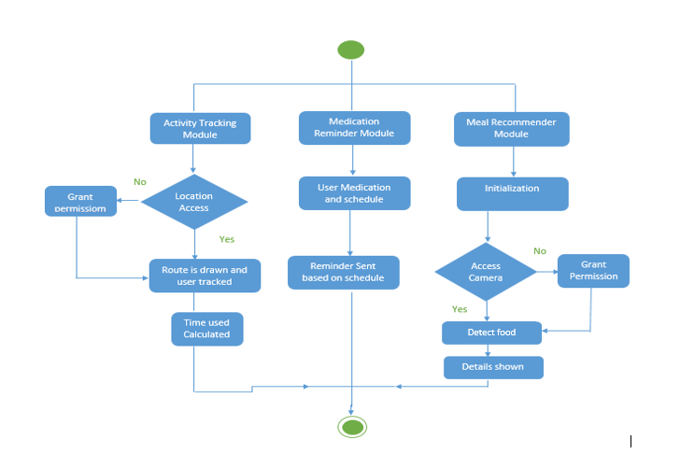
Activity Diagram
_______________________________

Slide 18
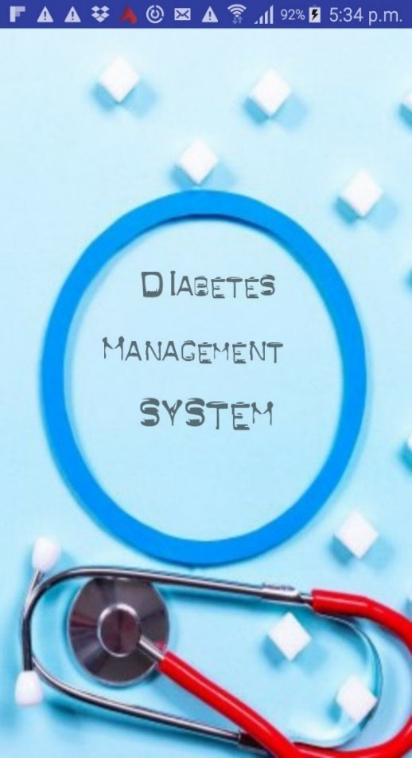
Application Snapshot
________ _________________

Slide 19
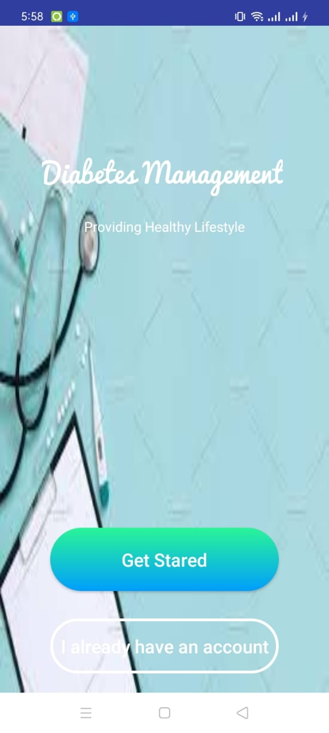
Registration Page
_______ __________________

Slide 20
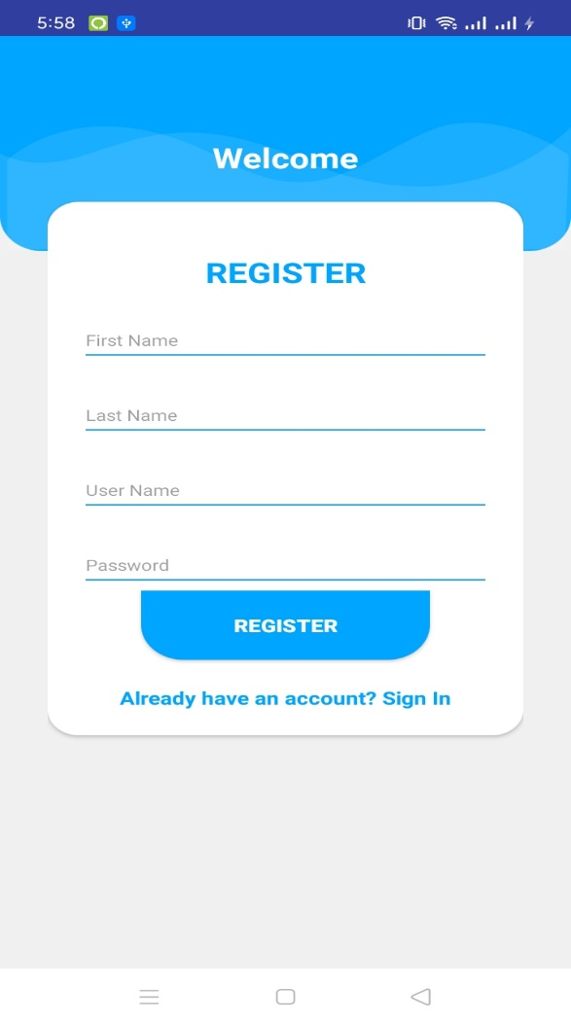
Sign Up Page
_________ ________________

Slide 21
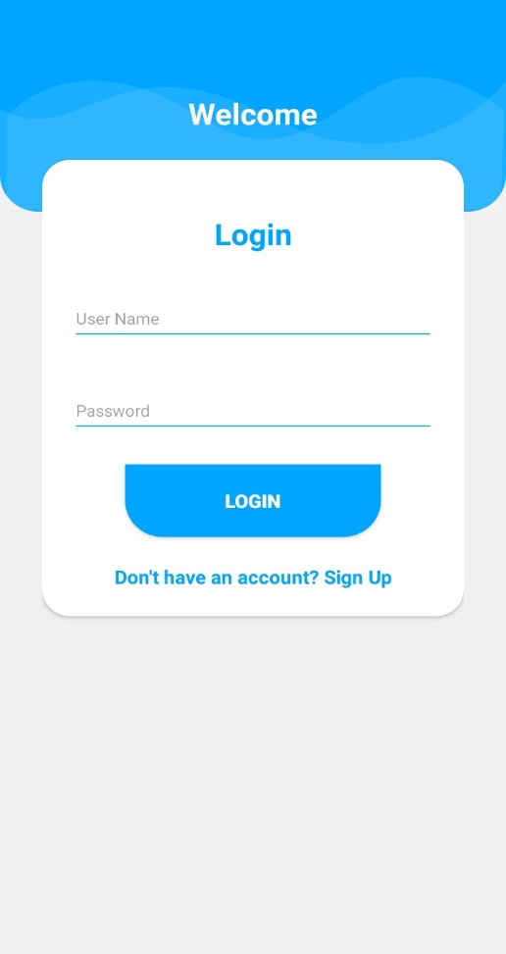
Login Page
______ ___________________

Slide 22
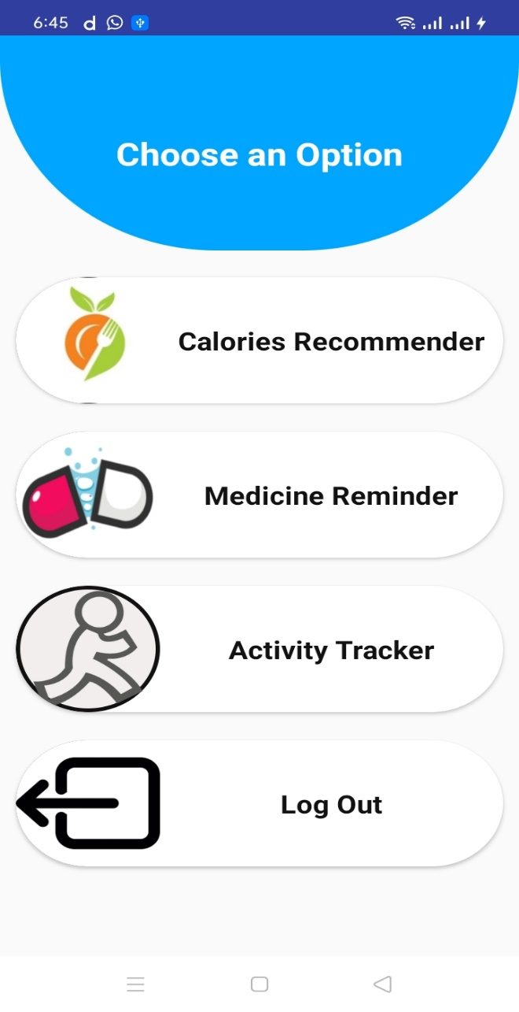
Home Page
____ _____________________

Slide 23
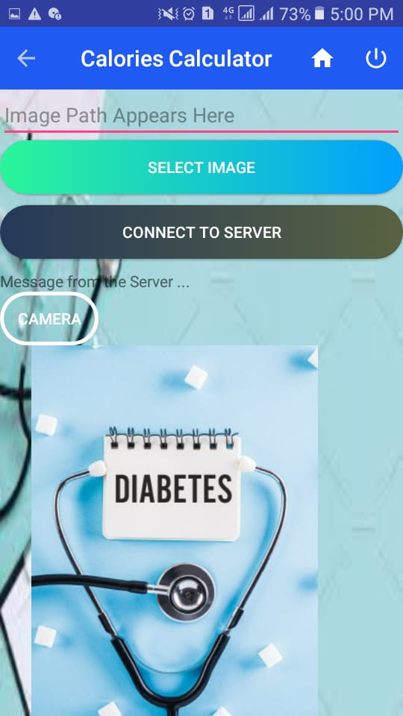
Calories Recommender
_____ ____________________

Slide 24
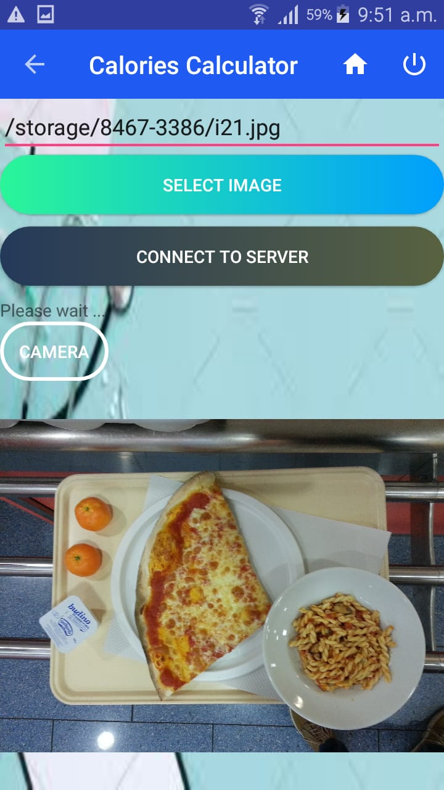
Selecting Image
________ _________________

Slide 25
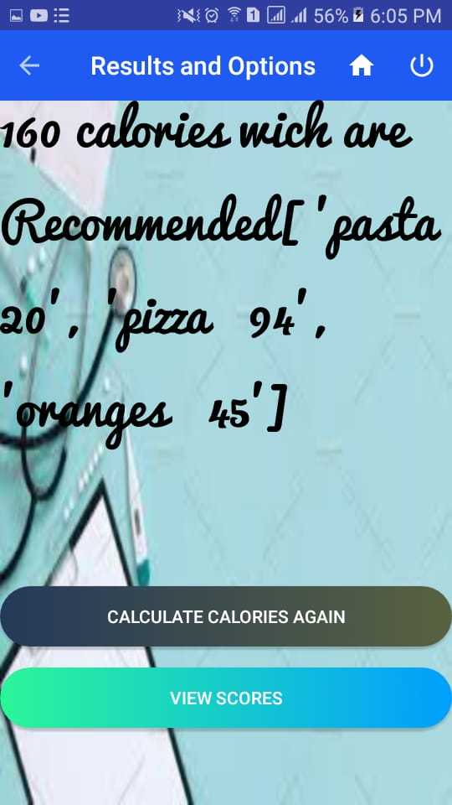
Results and Options
_______________________________

Slide 26
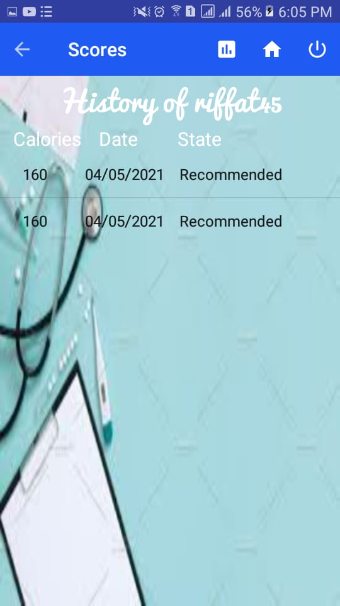
Score Page
_______________________________

Slide 27
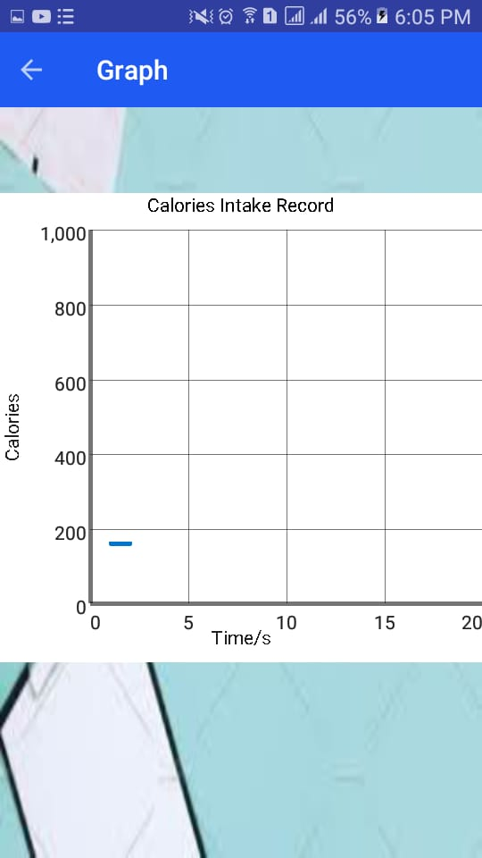
Graph Page
_______________________________

Slide 28
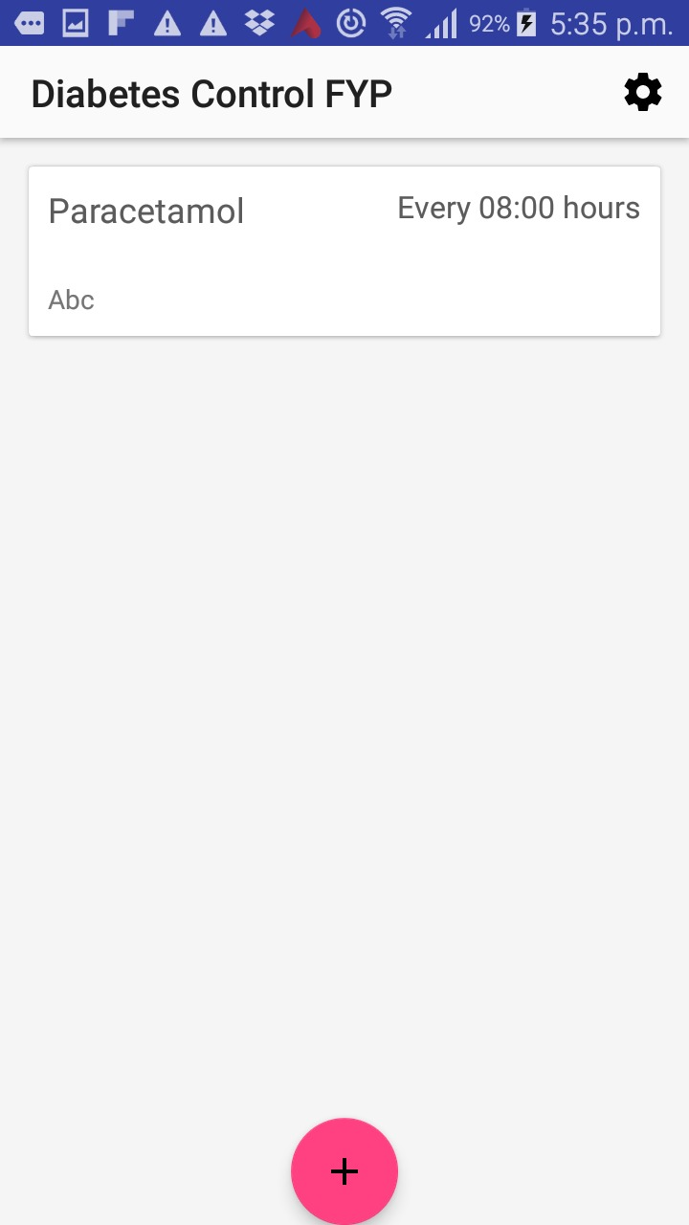
Medicine Reminder
_______________________________

Slide 29
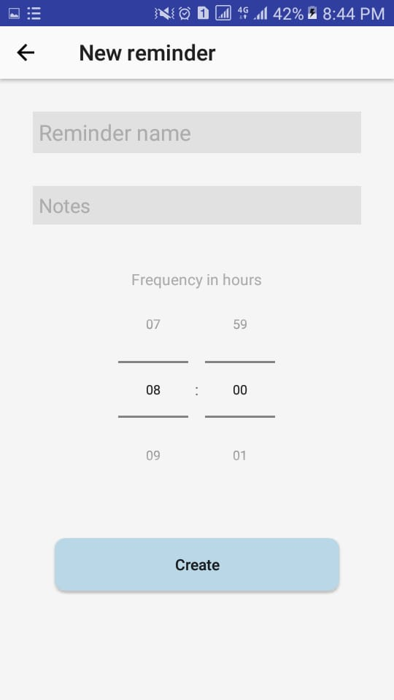
Create Reminder
_______________________________

Slide 30
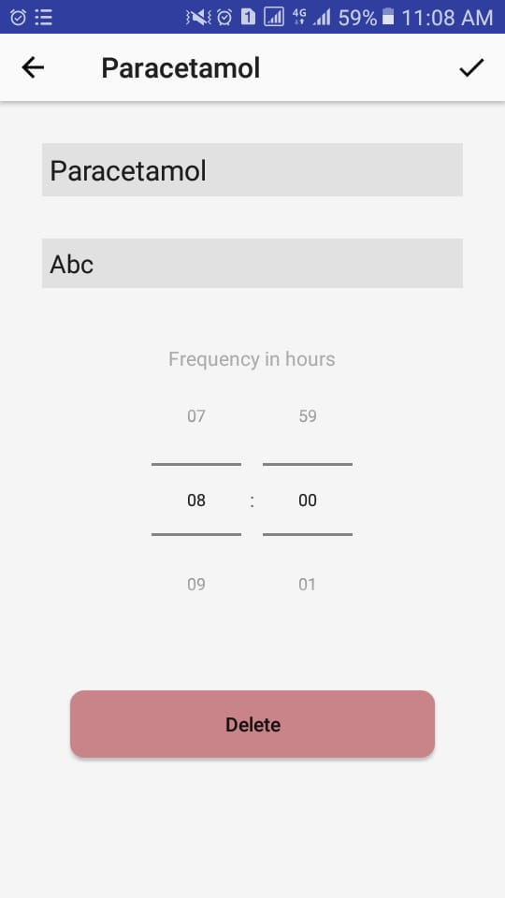
Edit / Delete Reminder
_______________________________

Slide 31
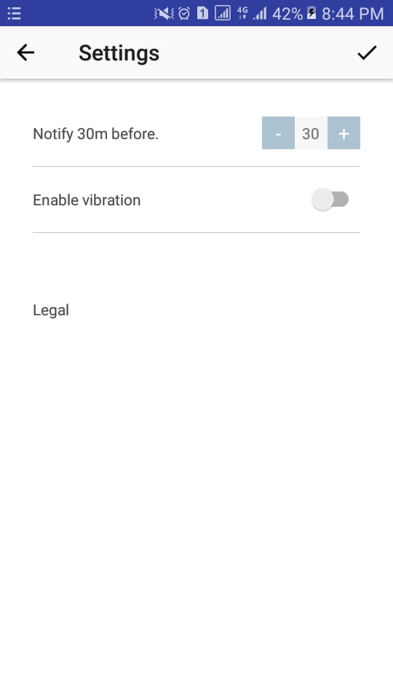
Notifications Settings
_______________________________

Slide 32
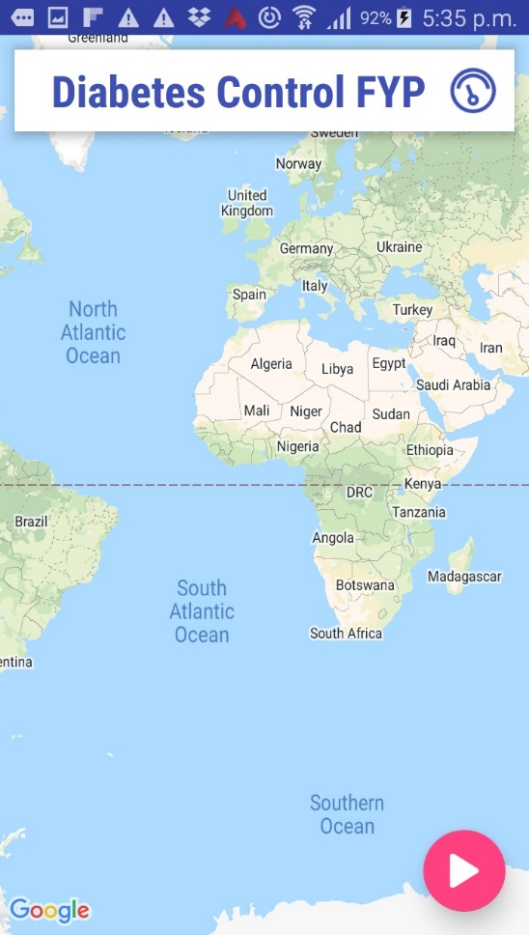
Activity Tracking
_______________________________

Slide 33
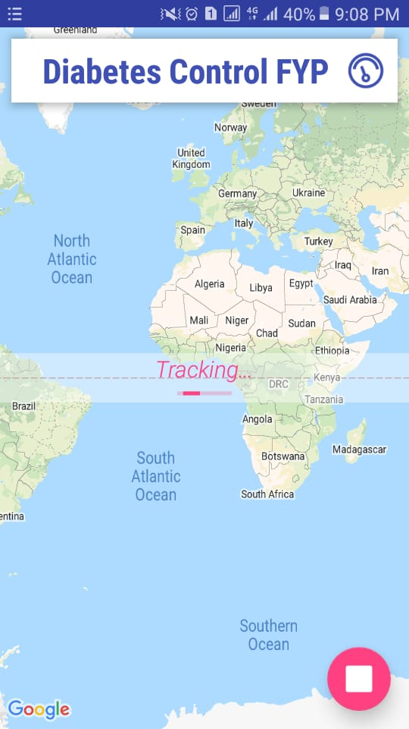
Activity Tracking
_______________________________

Slide 34
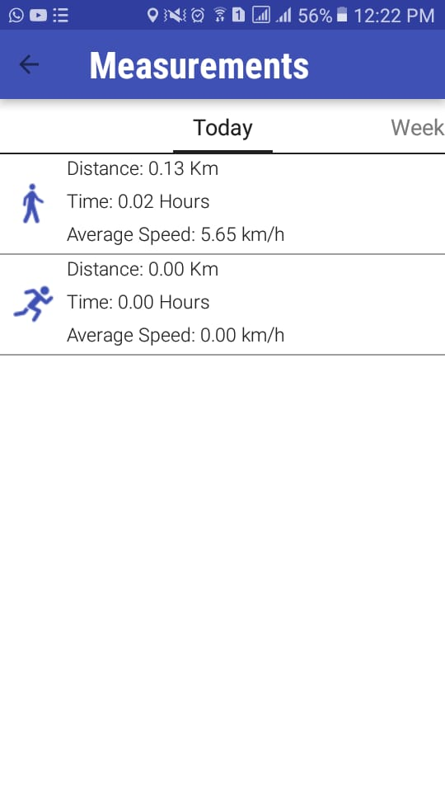
Activity Tracking
_______________________________

Slide 35
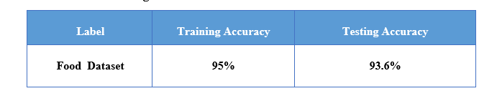
Conclusion
After implementing and testing whole system we conclude that
our system allow users to upload an image to find out if food is recommended for use or not.
R-CNN extract an image and spits out three outputs, masks of the identified items, bounding boxes and classes for each mask detected.
User tracking function keep record of route, and medication reminder for keeping record of medicine.
_______________________________

Slide 36
Future Work
In future,
we will add a platform where a user can easily consult to a doctor and find solution related to their health.
Application will track the client's walk and relate it to the calories consumed/burn.
Will add more classes of food.
_______________________________

Slide 37
Tools and Techniques
Tools:
Android Studio
Pycharm
Languages:
Machine learning (python)
Android (java)
MySQL(Database)
_______________________________

Slide 38

THANK YOU

